Slide 1

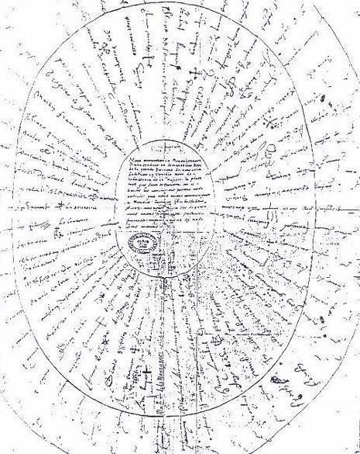
schindel@ictt.com
V1.2.1
Call for Project Participants
MBSE Patterns Working Group
IW2021 MBSE Workshop, 30 Jan 2021:
Working Groups ‘Round Robin’ Session
Round robin (n.): "petition or complaint signed in a circle to disguise the order in which names were affixed and prevent ringleaders from being identified," 1730, originally in reference to sailors and frequently identified as a nautical term. https://www.etymonline.com/word/round%20robin
Jessé de Forest's Round Robin from 1621
https://en.wikipedia.org/wiki/Round-robin_(document)

Slide 2
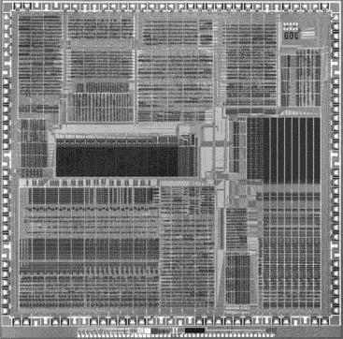

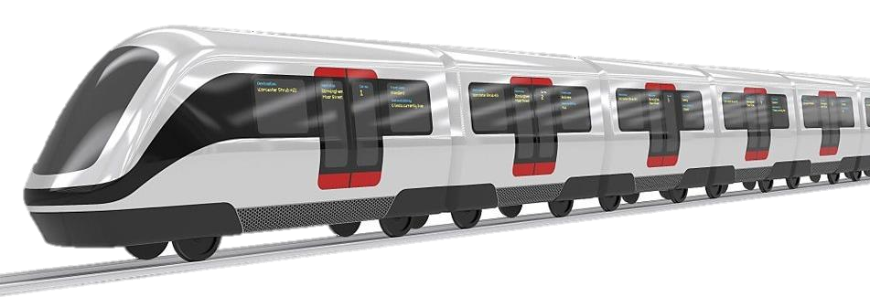
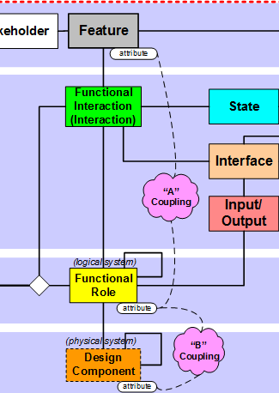

Focus of MBSE Patterns Working Group: S*Patterns
Configurable, re-usable system models:
Models containing a certain minimal set of elements are called S*Models (S* is
short for “Systematica”)
Those underlying elements are called the S*Metamodel, which was inspired by the physical sciences
S*Models using those elements may be (have been) expressed in any modeling language (e.g., OMG SysML, or other languages)
S*Models can be (have been) created and managed in many different COTS modeling tools.
Re-usable, configurable S*Models are called S*Patterns
By “Pattern-Based Systems Engineering” (PBSE) we mean MBSE enhanced by these
generalized assets
These are system-level patterns (models of whole managed platforms), not just
smaller-scale component design patterns

Slide 3
Current MBSE Patterns WG Projects, Activities
INCOSE SE Handbook, 5th Edition Project
INCOSE Vision 2035, SE Theoretical Foundations Project
Adaptive Learning Ecosystem Pattern—the ASELCM Reference Framework
Universal Model Metadata Wrapper: Model Characterization Pattern (MCP)
INCOSE MBSE Patterns Primer
Minimal S*Models—A Primer
Semantic Technologies for Systems Engineering (ST4SE) Project
Join and participate!

Slide 4
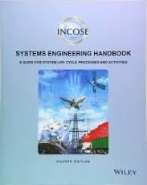
1. INCOSE SE Handbook, 5th Edition Project
The Patterns Working Group is contributing an
invited section on pattern-based methods to the
INCOSE SE Handbook, 5th edition project, now in generation.
The structure of the 5th Edition of the SE Handbook
is re-architected compared to past editions, based on progress and needs of the community.
Those interested in participating can contribute to
review of the related handbook material during
defined project phases, as the overall SE Handbook 5th Edition progresses during 2021.
Initial review held during IW2021 meetings.
Current (4th) Edition
Overall project is led by INCOSE Handbook Editorial Team, chaired by Dave Walden.

Slide 5


2. INCOSE Vision 2035, SE Theoretical Foundations Project
The Patterns Working Group is providing the SE Theoretical Foundations section of INCOSE Vision 2035 publication project, now underway.
At IW2020, an initial conceptual review with a set of expert reviewers was held, since followed by drafting of the related sectional material.
This includes a community-wide Roadmap for the advancement of SE Practice, Education, and Research, based on the impacts of these strengthened foundations.
Those interested in participating can be a part of the diverse future activities listed in that roadmap over the coming periods, beginning with review of the materials to date.
Overall INCOSE project is led by editorial team
chaired by Sandy Friedenthal.
Current (Vision 2025) Edition

Slide 6
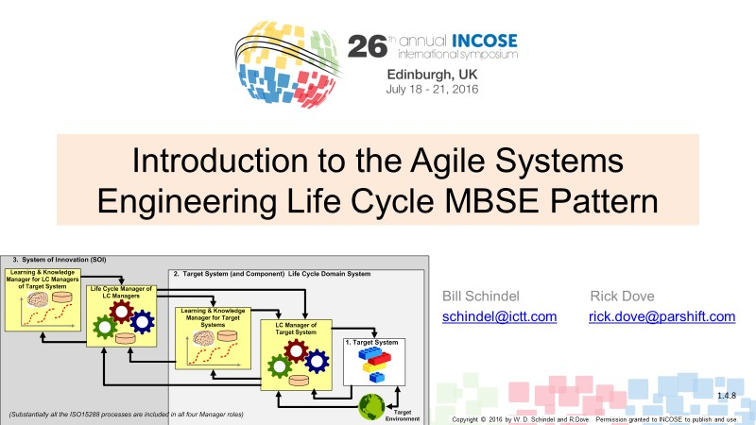
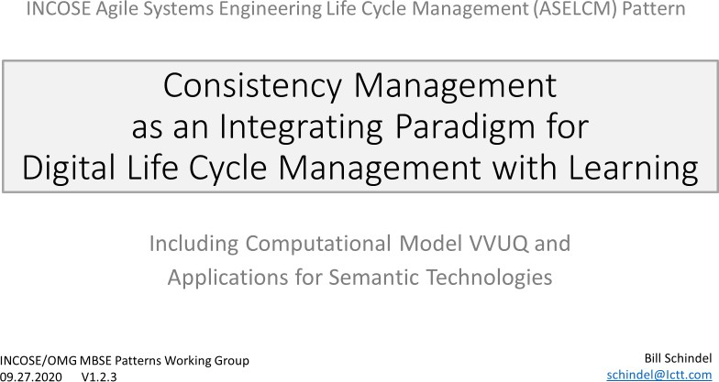
3. Adaptive Learning Ecosystem Pattern—the Learning Ecosystem (ASELCM) Reference Framework
Collaborating with the INCOSE Agile SE WG, a reference pattern was contributed by the Patterns WG as part of the two-year INCOSE study of agile SE practices of four major organizations during 2015-2017, leading to its application in four published case studies. (Led by Rick Dove, Agile SE WG.)
That original pattern (Agile SE Life Cycle Management (ASELCM) Operational Reference Pattern) has subsequently been formalized by the Patterns WG as a configurable S*Pattern in SysML, for the planning, analysis, and management of advancement in learning ecosystems for projects, enterprises, and supply chains.
The resulting multi-layer pattern focuses on leveraging Digital Engineering to advance performance through the paradigm of strengthened Consistency Management.
Those interested in participating can be a part of extension and application of this pattern in case studies of their own projects, enterprises, or supply chains, plus related tooling.
http://www.omgwiki.org/MBSE/lib/exe/fetch.php?media=mbse: patterns:is2016_intro_to_the_aselcm_pattern_v1.4.8.pdf
http://www.omgwiki.org/MBSE/lib/exe/fetch.php?media=mbse:patt erns:aselcm_pattern_--
_consistency_management_as_a_digital_life_cycle_management_p aradigm_v1.2.2.pdf

Slide 7
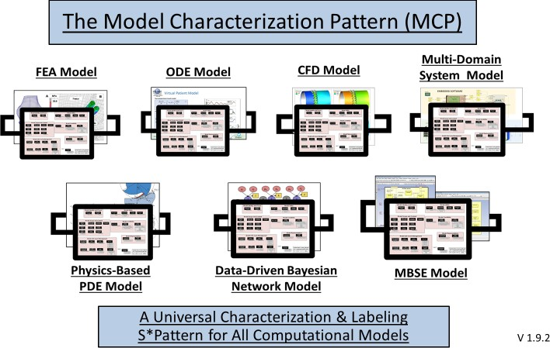
4. Universal Model Metadata Wrapper: The Model Characterization Pattern (MCP)
Collaborating with the ASME Standards Committee on Model Credibility, VV50 Subcommittee, the Patterns WG has created a configurable pattern for representing metadata on any virtual model, including Machine Learning, Simulation (FEA, CFD, SD, ODE), MBSE, or otherwise. (ASME WG led by Joe Hightower.)
This universal metadata framework includes Model Identify and Focus, Model Utility, Model Scope and Content, Model Credibility, Model Representation, and Model Life Cycle Management.
Those interested in participating can be a part of continued testing and feedback on the application of the MCP to model library organization and management, model exchanges and markets, and model life cycle credibility management.
http://www.omgwiki.org/MBSE/lib/exe/fetch.php?media=mbse
:patterns:model_characterization_pattern_mcp_v1.9.3.pdf

Slide 8
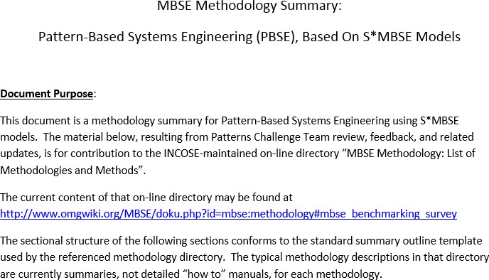
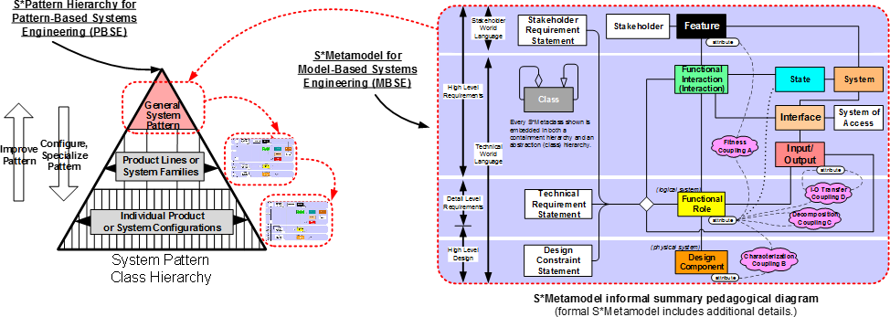
5. MBSE Patterns Primer
The Patterns WG generated an introduction and overview of pattern-based methods and their relationships with other subjects—this was several years ago and before the emergence of newer INCOSE Tech Ops approaches to INCOSE Technical Product “primers” on various subjects supported by the working groups.
This project is concerned with recasting the earlier publication in the form of an updated “Primer” on model-based patterns and related subjects.
Those interested in participating can be a part of review of the earlier document and newer INCOSE primers, regeneration of an updated primer form asset, or review of the resulting document for submission as a Technical Product.
http://www.omgwiki.org/MBSE/lib/exe/fetch.php?m edia=mbse:patterns:pbse_extension_of_mbse-- methodology_summary_v1.6.1.pdf

Slide 9
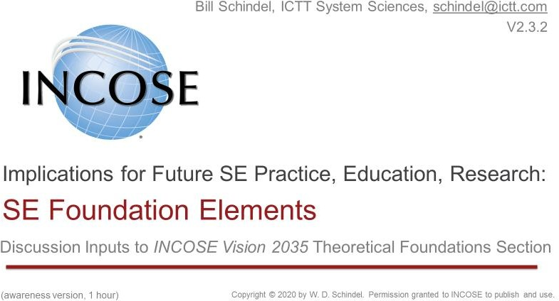
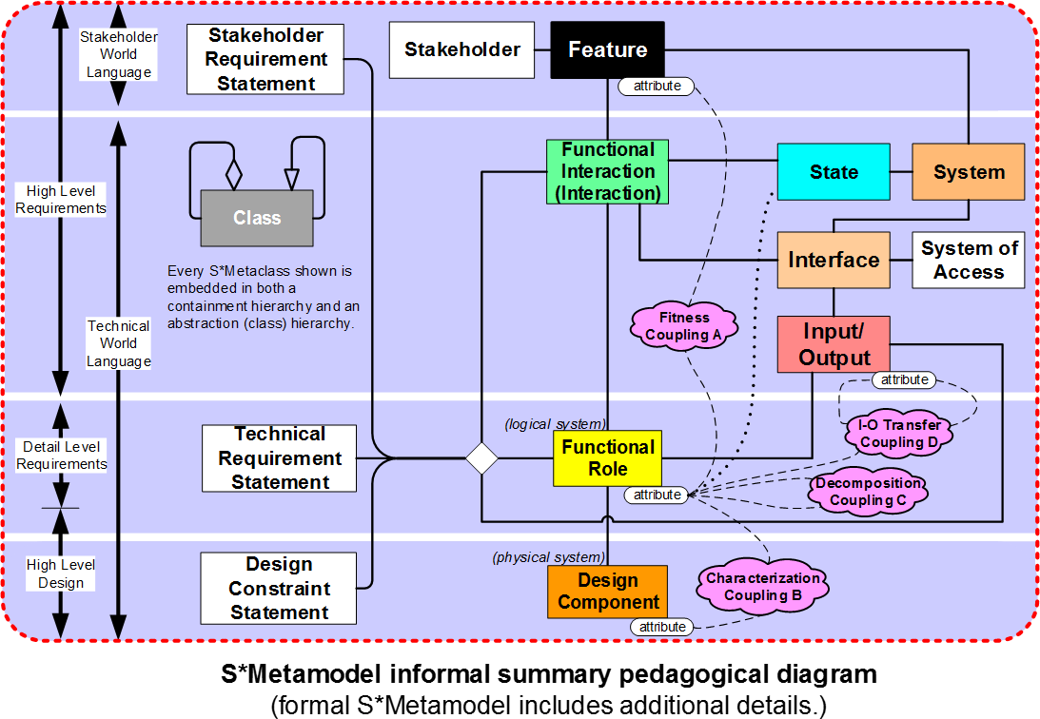
6. Minimal S*Models—A Primer
The laws of nature which are the basis of the natural sciences
are all formal descriptions of recurring patterns associated with observable phenomena (things that happen).
Finding the smallest model-based representation of those
patterns has important practical as well as theoretical importance.
The practical importance is reduction of unnecessary
proliferation of information that is redundant and often
inconsistent or conflicting.
The theoretical importance is that size of minimal models is one of formal measures of (Kolmogorov) complexity.
Independent of choices of modeling languages, tools, and
methods, we want to base our representation of system
patterns on the simplest framework necessary for the
purposes of engineering and science over the life cycle of systems.
This Primer is to describe the S*Metamodel—a long-tested
pattern based on the history of physical sciences and engineering, focused on the minimal information set.
Those interested in participating can be a part of writing and review of this S*Metamodel Primer—including examples.
http://www.omgwiki.org/MBSE/lib/exe/fetch.php?media=mbse
:patterns:science_math_foundations_for_systems_and_system s_engineering--1_hr_awareness_v2.3.2a.pdf

Slide 10
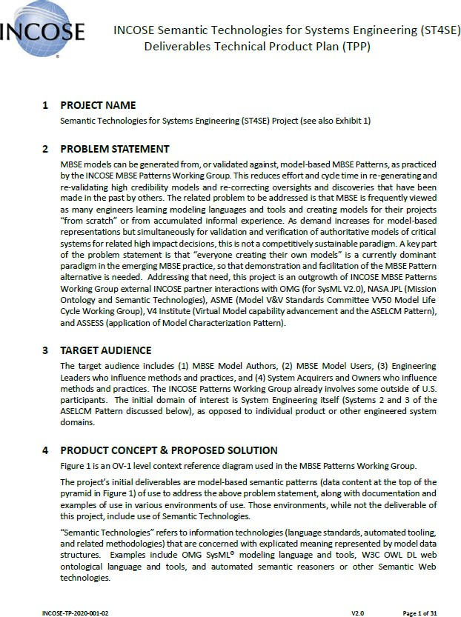
7. Semantic Technologies for Systems Engineering
(ST4SE)
Human beings may be the original interpreters of the meaning of
models, but non-human semantic technologies have joined them.
Information technologies that deal with model semantics (relationally encoded meaning) include modeling languages, model authoring tools, simulation engines, web-based semantic data structures, and query and reasoning technologies for retrieving views and implications of semantic models.
Semantic technologies offer to supplement human SE skills with IT- based abilities to strengthen the ability for model-based semantics to impact engineering work.
This project is merging demonstration of (1) [automated generation of
consistent trustable models from trusted model-based patterns] with
(2) [automated checking of human-generated models against trusted model-based patterns].
This project is the second phase of the Interface Patterns Project of the MBSE Patterns WG, under a newer Technical Product Plan that includes exploration of INCOSE Product distribution of pattern data structures that are not themselves documents.
Those interested in participating can be a part of evaluating the utility of the combination as well as the new shared patterns distribution paradigm.
http://www.omgwiki.org/MBSE/lib/exe/fetch.php?media=mbse:patter
ns:incose_patterns_wg_st4se_project_tpp_v2.0_signed.pdf

Slide 11
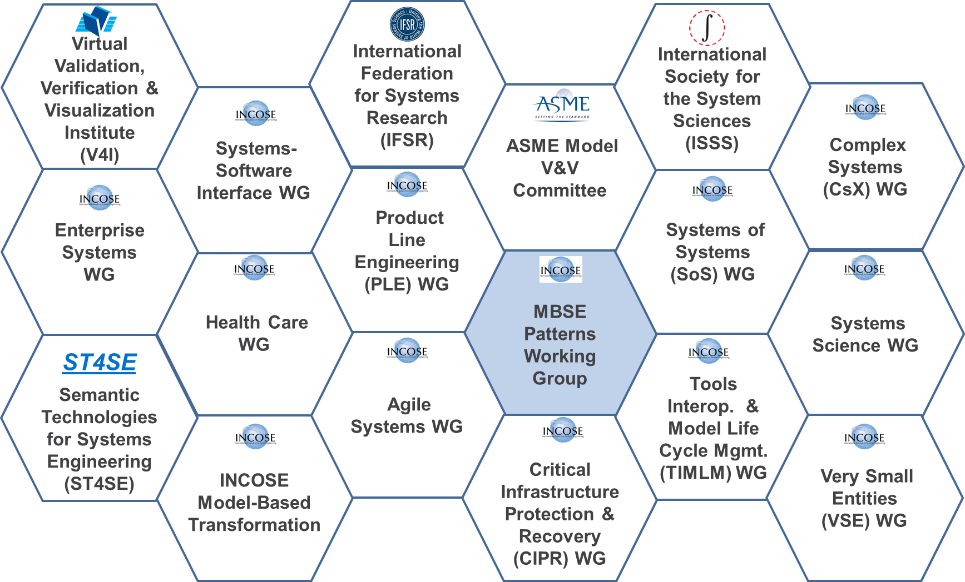
Nearly all our work includes partner INCOSE WGs or others
Participate!
Contact: Bill Schindel schindel@ictt.com

Slide 12
References
“SE Foundation Elements: Implications for Future SE Practice, Education, Research”. Retrieve from--
http://www.omgwiki.org/MBSE/lib/exe/fetch.php?media=mbse:patterns:science_math_foundations_for_systems_and_sys tems_engineering--1_hr_awareness_v2.3.2a.pdf
“The Model Characterization Pattern (MCP): A Universal Characterization & Labeling S*Pattern for All Computational
Models”. Retrieve from -- http://www.omgwiki.org/MBSE/lib/exe/fetch.php?media=mbse:patterns:model_characterization_pattern_mcp_v1.9.3.pdf
“Introduction to the Agile Systems Engineering Life Cycle MBSE Pattern”. Retrieve from -- http://www.omgwiki.org/MBSE/lib/exe/fetch.php?media=mbse:patterns:is2016_intro_to_the_aselcm_pattern_v1.4.8.pdf
“Consistency Management as an Integrating Paradigm for Digital Life Cycle Management with Learning:”
http://www.omgwiki.org/MBSE/lib/exe/fetch.php?media=mbse:patterns:aselcm_pattern_--
_consistency_management_as_a_digital_life_cycle_management_paradigm_v1.2.2.pdf
“INCOSE Semantic Technologies for Systems Engineering (ST4SE): Deliverables Technical Product Plan (TPP)”. Retrieve from--
http://www.omgwiki.org/MBSE/lib/exe/fetch.php?media=mbse:patterns:incose_patterns_wg_st4se_project_tpp_v2.0_sig ned.pdf
“MBSE Methodology Summary: Pattern-Based Systems Engineering (PBSE), Based on S*MBSE Models”. Retrieve from –
http://www.omgwiki.org/MBSE/lib/exe/fetch.php?media=mbse:patterns:pbse_extension_of_mbse-- methodology_summary_v1.6.1.pdf
“What Is the Smallest Model of a System?” Retrieve from --
http://www.omgwiki.org/MBSE/lib/exe/fetch.php?media=mbse:patterns:what_is_the_smallest_model_of_a_system_v1.4. 4.pdf
MBSE Patterns Working Group web sites:
Public-facing (main resources, INCOSE joint with OMG): http://www.omgwiki.org/MBSE/doku.php?id=mbse:patterns:patterns
Inward-facing (incose.org): https://www.incose.org/incose-member-resources/working-groups/transformational/mbse-patterns

